Slide 1
Multimedia Computing
By
Minhaz Uddin Ahmed, PhD
Department of Computer Engineering
Inha University in Tashkent.
Email: minhaz.ahmed@gmail.com

Slide 2
Content
Basic concept in digital image processing.
Elements of Human Visual Perception
Object perception
Light and EM Spectrum
Basics of image acquisition
A (2D) Image
Store an Image
Set Operations Based on Coordinates
Image resampling

Slide 3
Basic Concepts in Digital Image Processing
Introducing some basic concepts in digital image processing
• Human vision system
• Basics of image acquisition

Slide 4
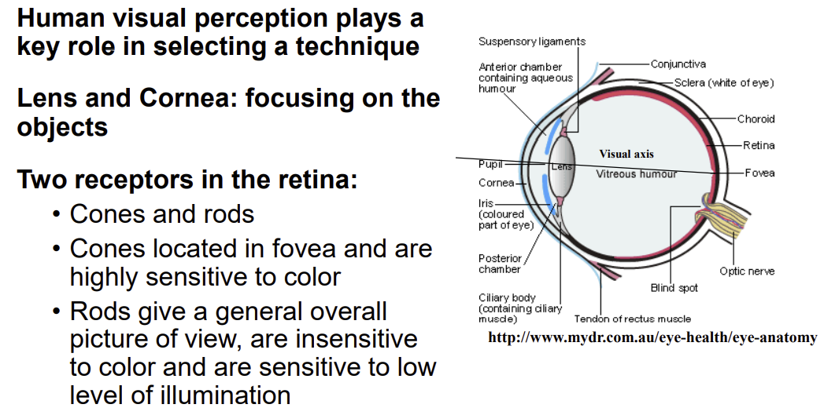
Elements of Human Visual Perception

Slide 5
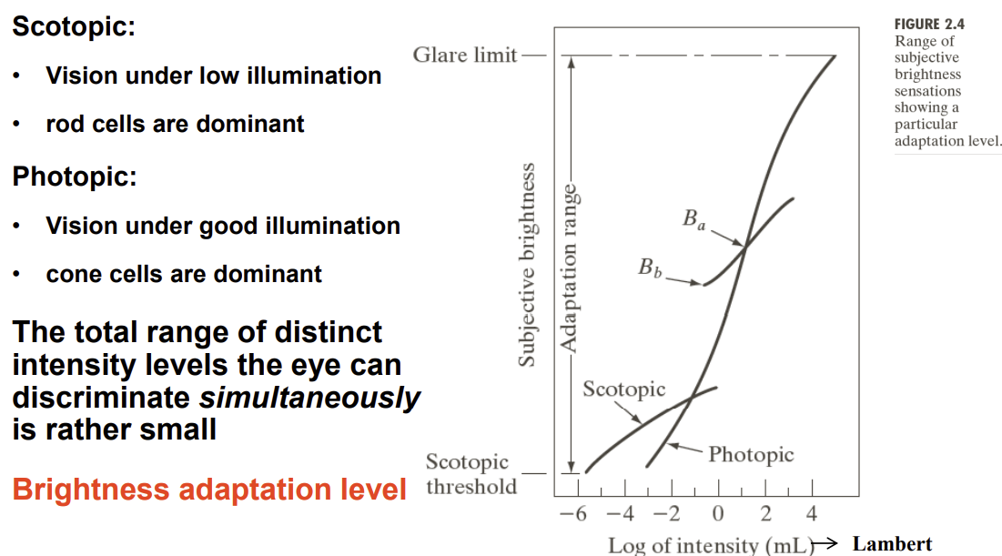
Brightness Adaptation: Subjective Brightness
Scotopic vision uses only rods to see, meaning that objects are visible, but appear in black and white, whereas photopic vision uses cones and provides color.

Slide 6
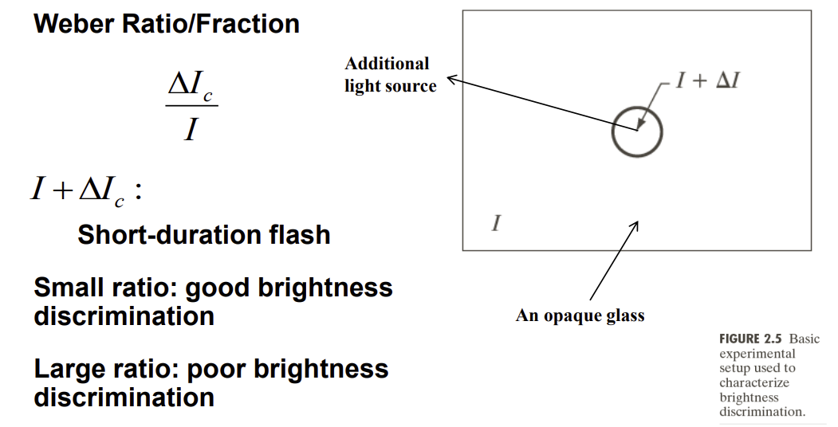
Brightness Discrimination
To characterize the intensity discrimination properties of eye ∆I starts at zero and is increased slowly • The observer is asked to indicate when the circle on the constant background becomes visible (just noticeable difference).
• The ratio ∆I/I is called the Weber ratio.

Slide 7
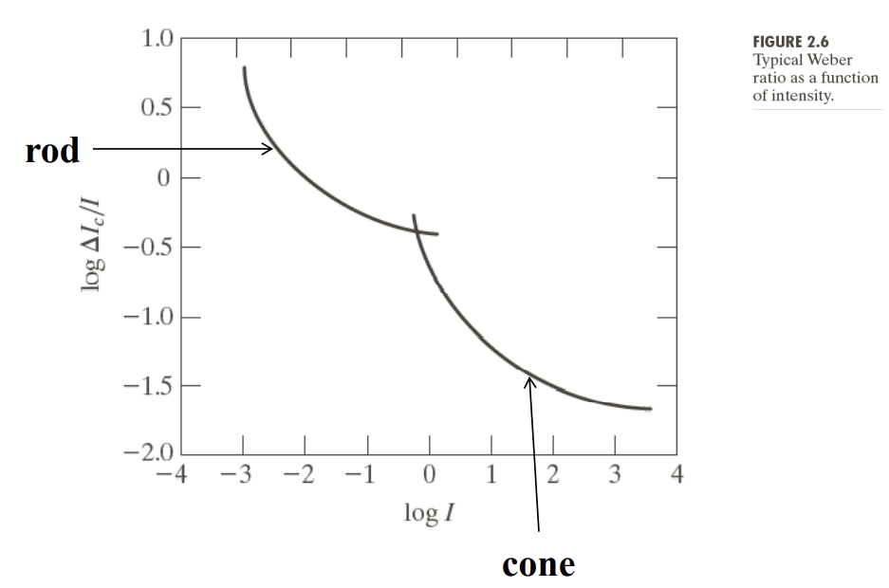
Brightness Discrimination at Different Intensity Levels

Slide 8
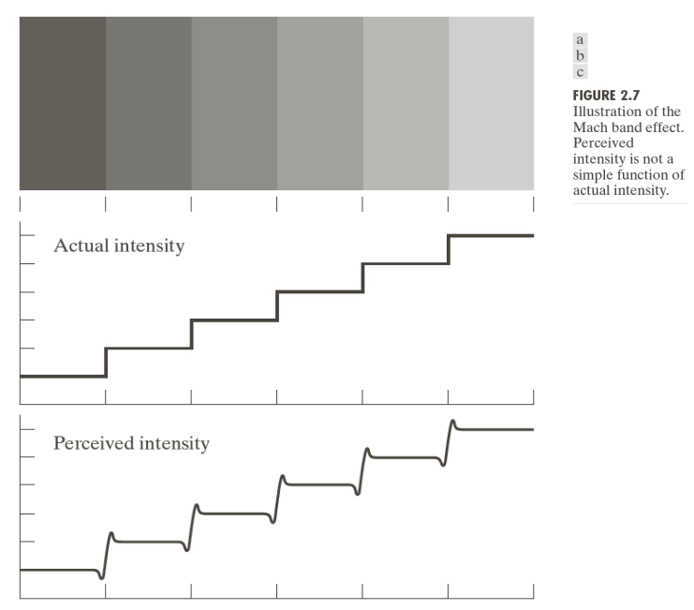
Perceived Intensity is Not a Simple Function of the Actual Intensity

Slide 9
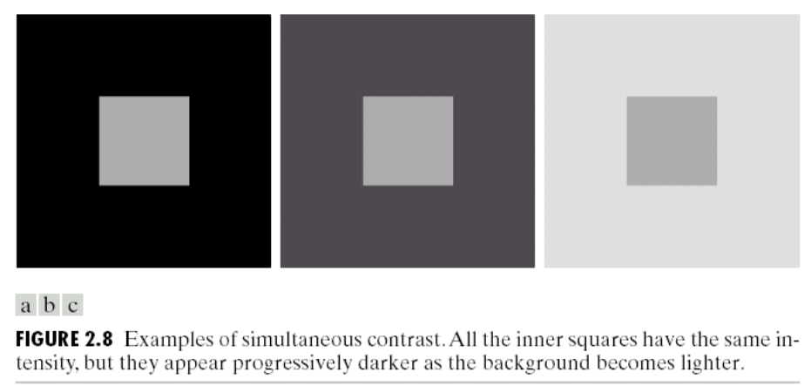
Perceived Intensity is Not a Simple Function of the Actual Intensity – Simultaneous Contrast

Slide 10
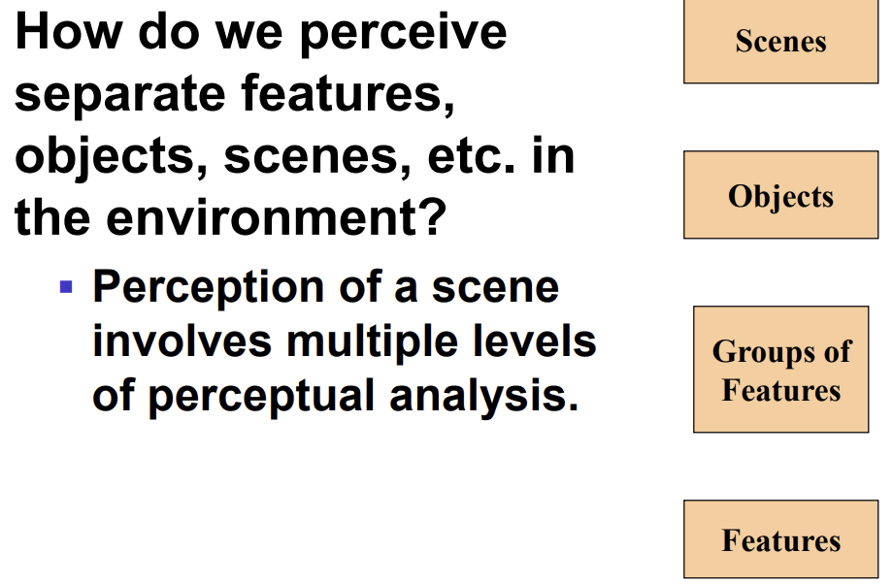
Object perception

Slide 11
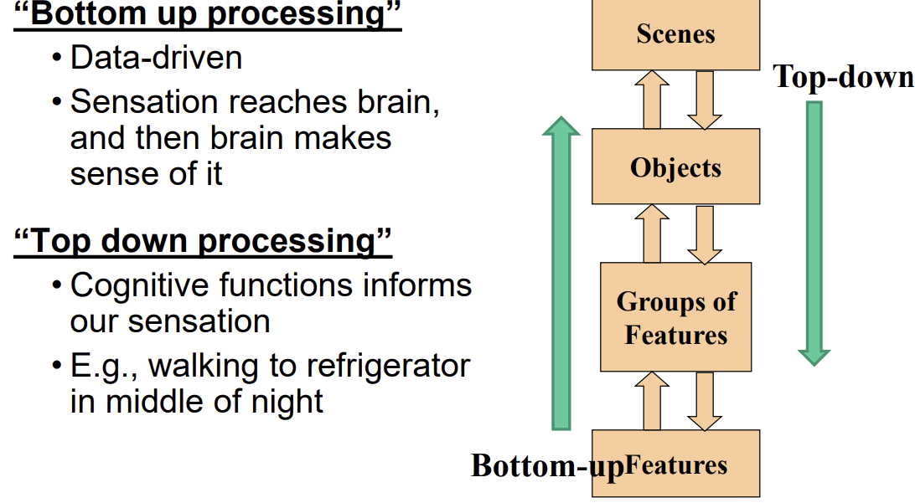
What Do We Do With All Of This Visual Information??

Slide 12
Basics of image acquisition
Geometry – size, location, …
Appearance – color, intensity

Slide 13
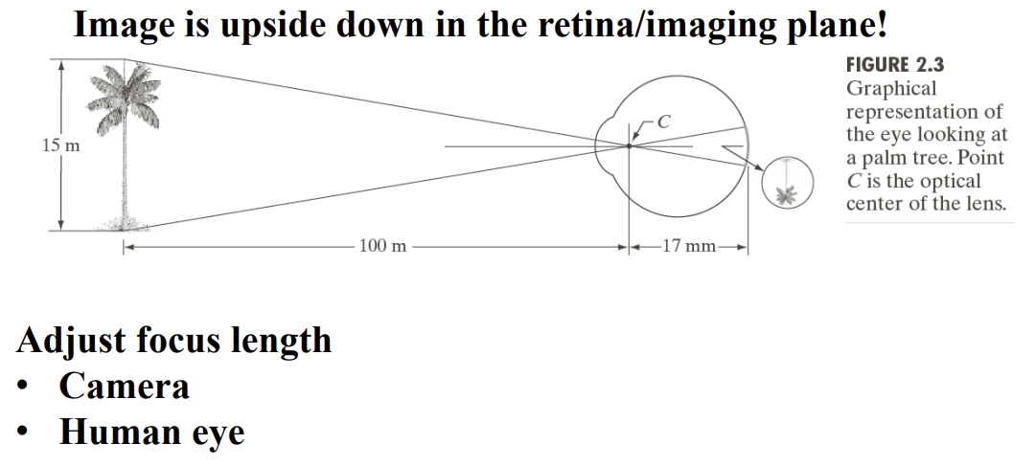
Image Formation in the Eye

Slide 14
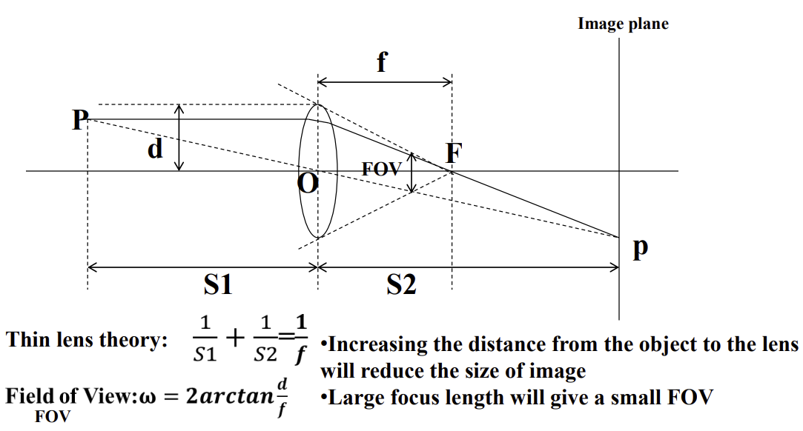
Lens Parameters

Slide 15
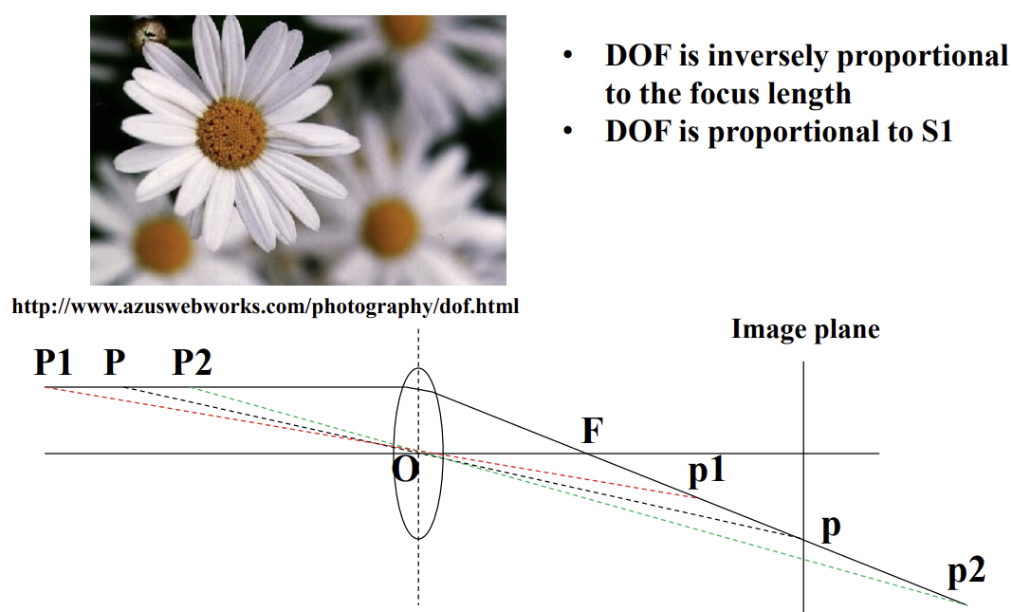
Depth of Field & Out of Focus
Lens focal length tells us the angle of view—how much of the scene will be captured—and the magnification—how large individual elements will be. The longer the focal length, the narrower the angle of view and the higher the magnification

Slide 16
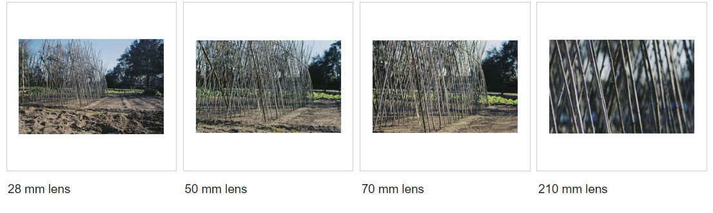
how lens choice affects angle of view.
The photos were taken by a 35 mm camera at a constant distance from the subject.

Slide 17
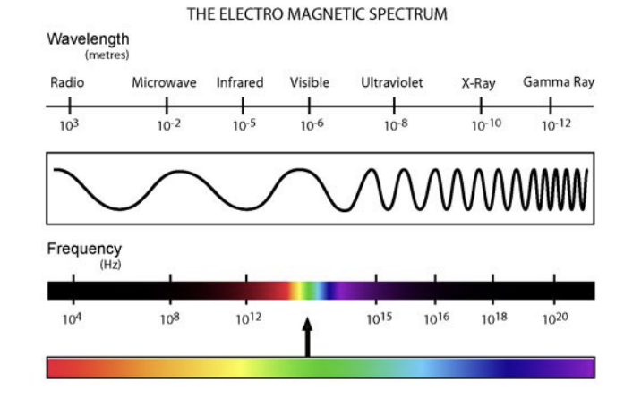
Light and EM Spectrum
sun, like any other hot object, releases its energy in discrete "rays" that have some properties of particles and some properties of waves call it electromagnetic radiation
Notes:
this range of wavelengths is called visible light. Typically, the human eye can detect wavelengths from 380 to 700 nanometers

Slide 18
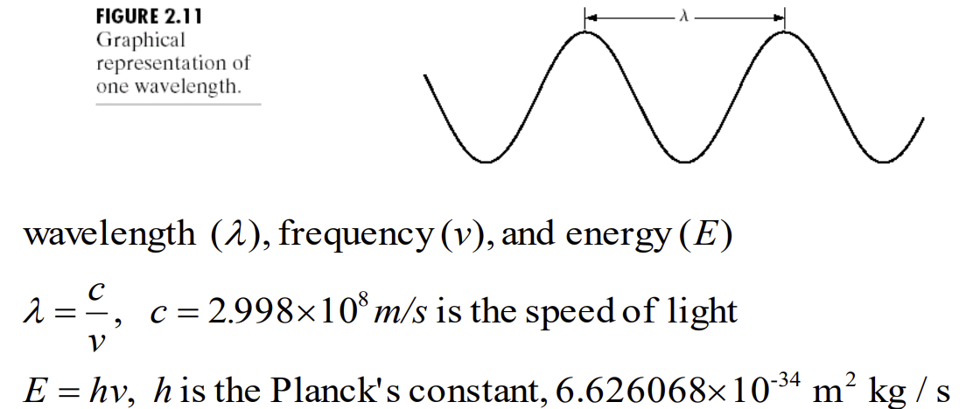
Relation Among Wavelength, Frequency and Energy

Slide 19
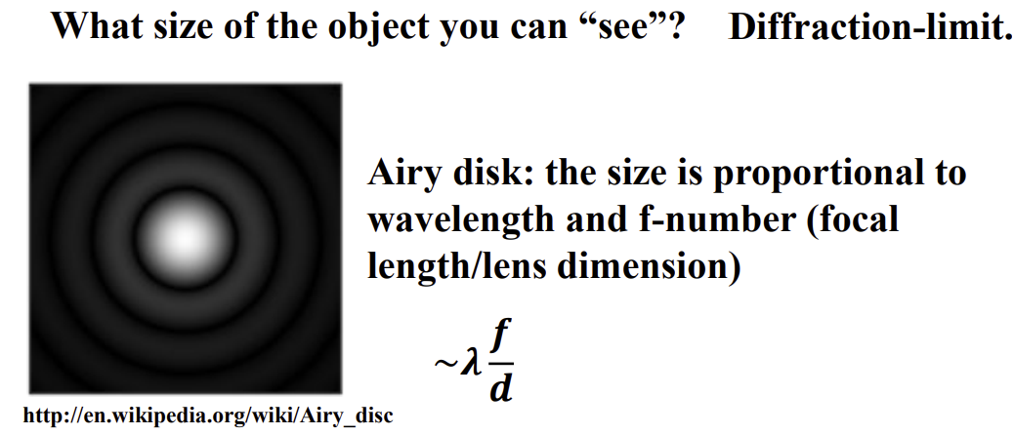
Light and EM Spectrum
Airy pattern are descriptions of the best-focused spot of light that a perfect lens with a circular aperture can make, limited by the diffraction of light. The Airy disk is of importance in physics, optics, and astronomy.

Slide 20
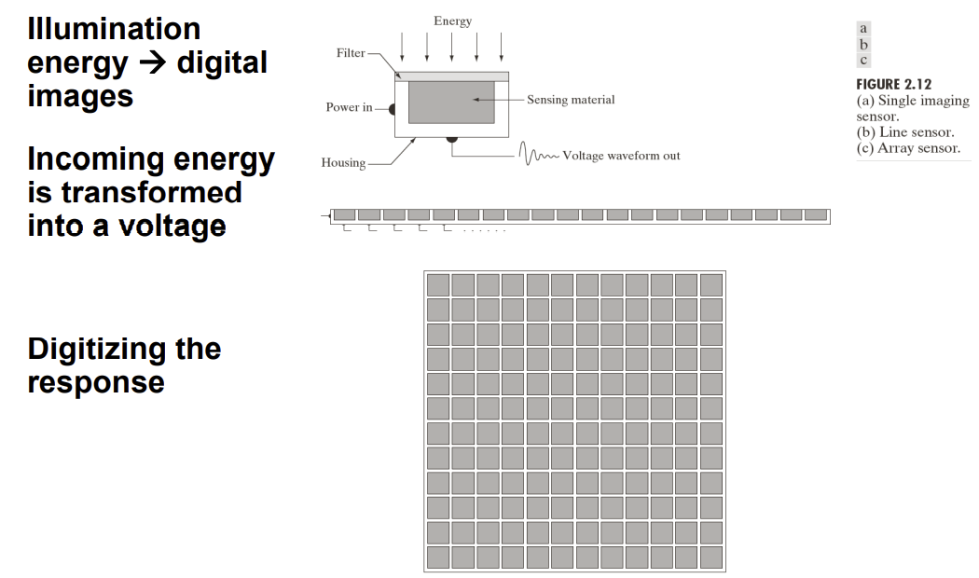
Image Sensing and Acquisition

Slide 21
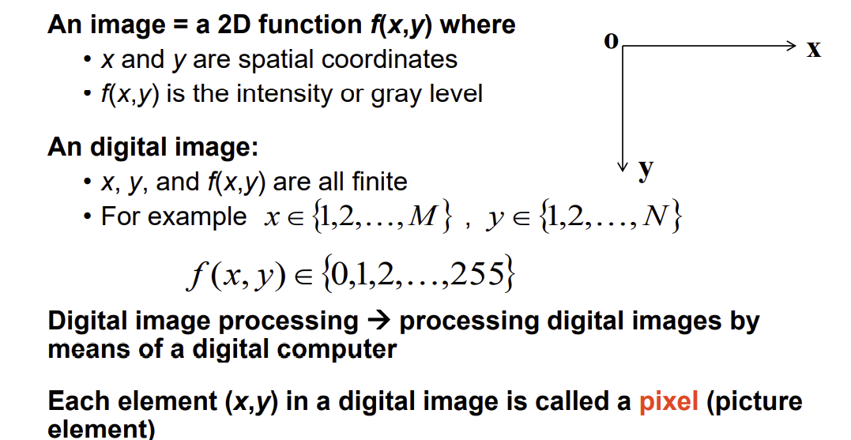
A (2D) Image

Slide 22
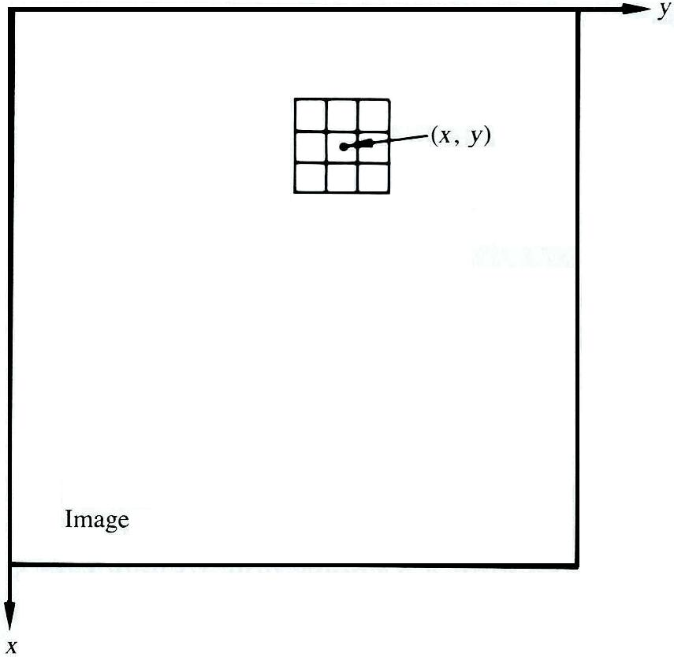
Spatial domain methods
The model for image processing
Let T be an operator in f defined over some neighborhood of (x,y) or a set of input image
g(x,y) = T[f(x,y)]
  g(x,y): processed image
  f(x,y): input image
A3 × 3 neighborhood about a point (x,y) in an image [Gonzalez]

Slide 23
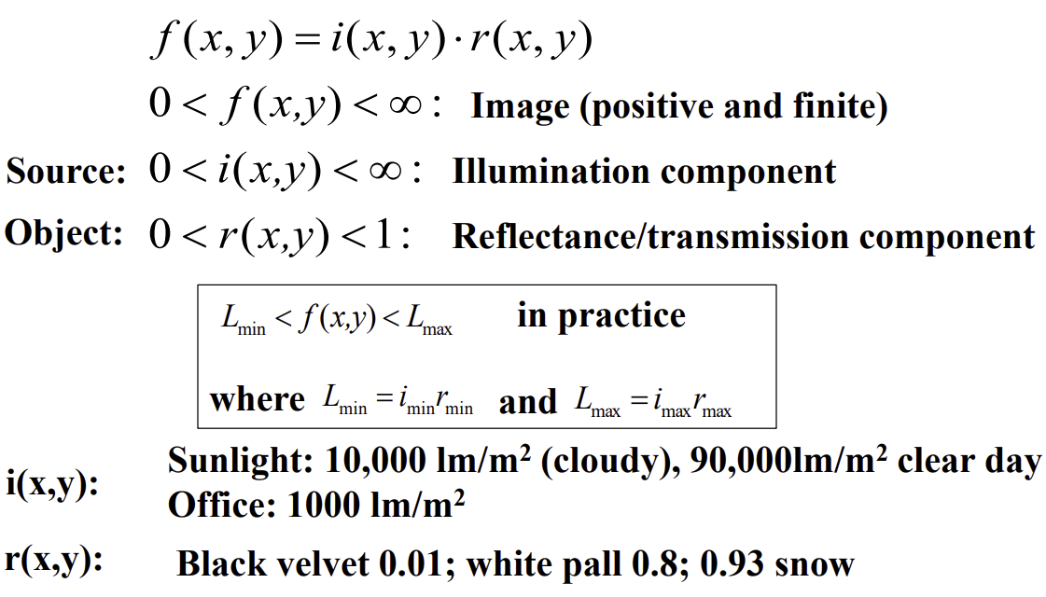
A Simple Image Formation Model

Slide 24
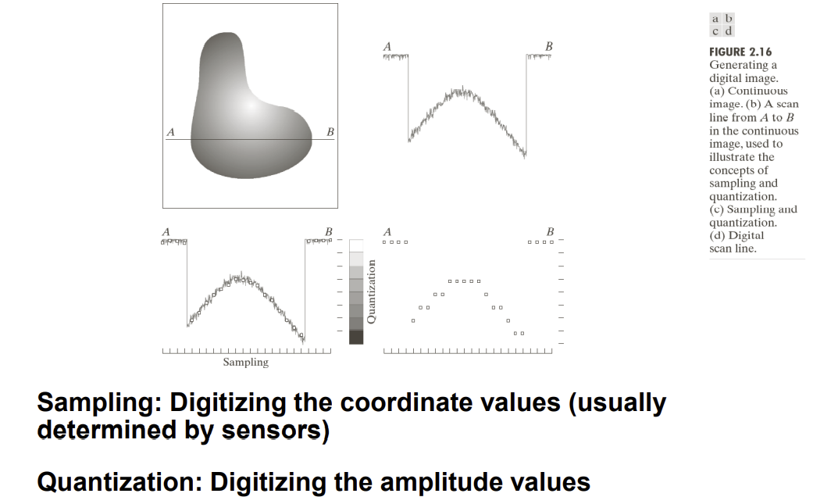
Image Sampling and Quantization

Slide 25
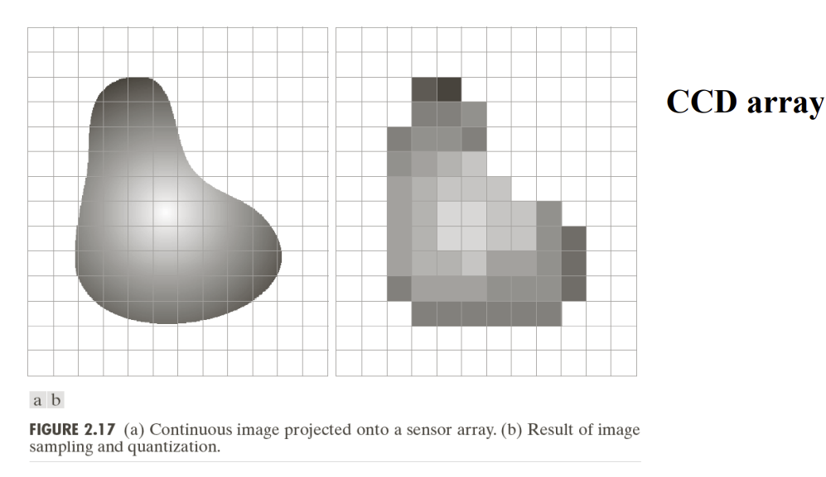
Image Sampling and Quantization in a Sensor Array

Slide 26
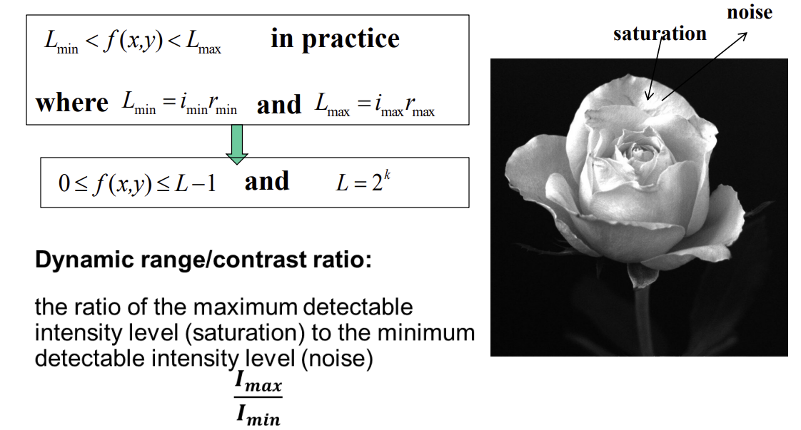
Dynamic Range

Slide 27
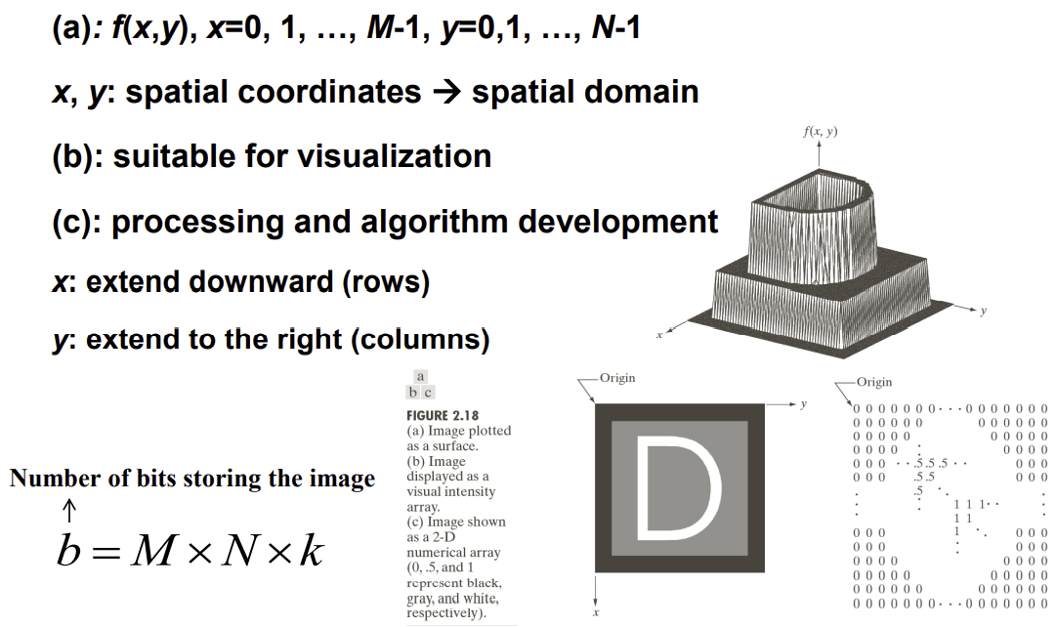
Representing Digital Images

Slide 28
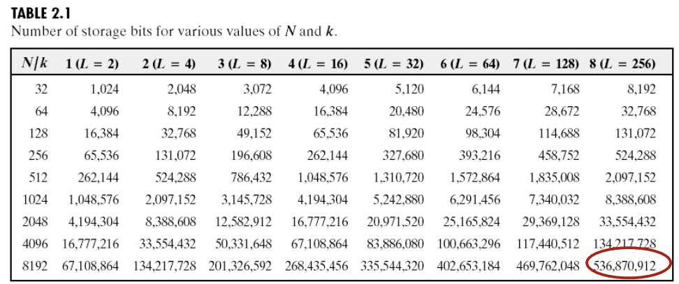
Store an Image

Slide 29
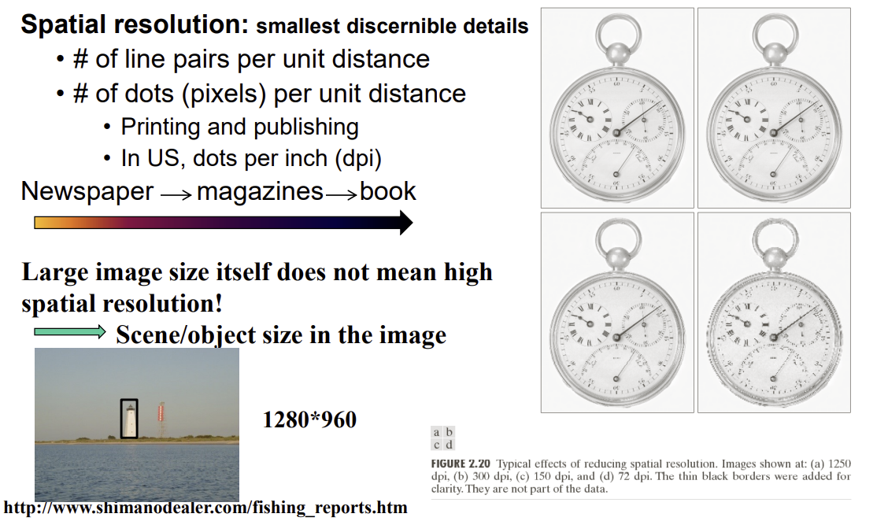
Spatial Resolution

Slide 30
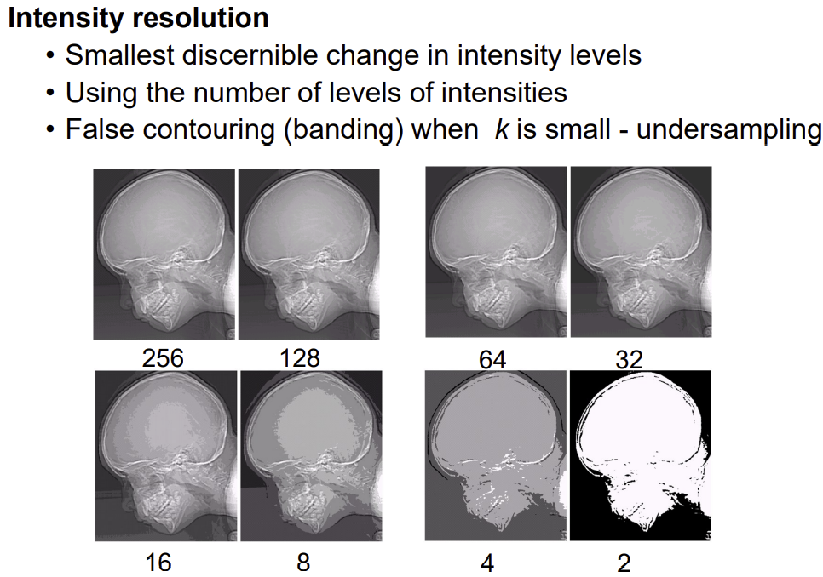
Intensity Resolution

Slide 31
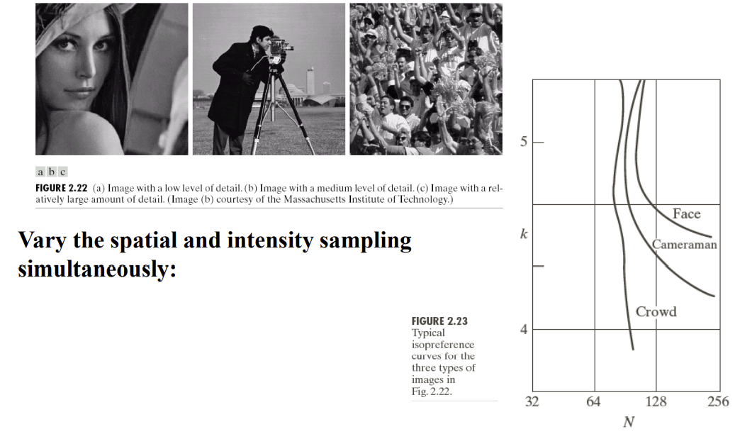
Isopreference Curves
Notes:
Used to demonstrate the effects produced on image quantities. It happens by changing the values of N and K independently. Here, N is the total number of pixels in an image and K refers to the total number of bits in each pixel of that image

Slide 32
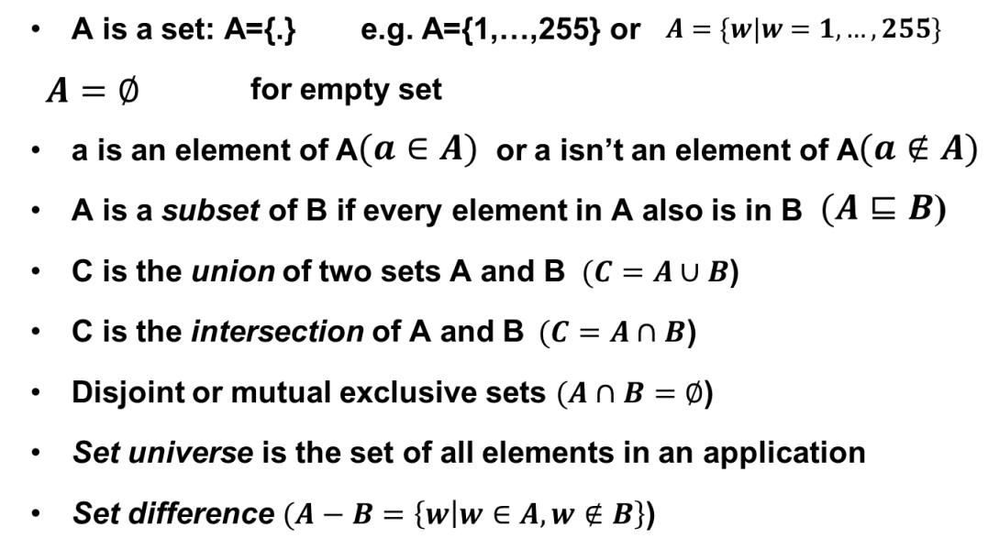
Basic Set and Logical Operations

Slide 33
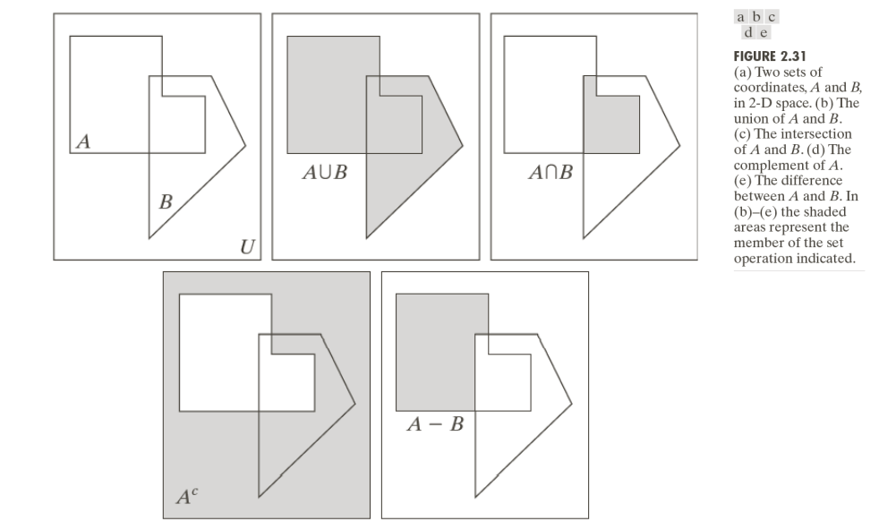
Set Operations Based on Coordinates
A region in an image is represented by a set of coordinates within the region

Slide 34
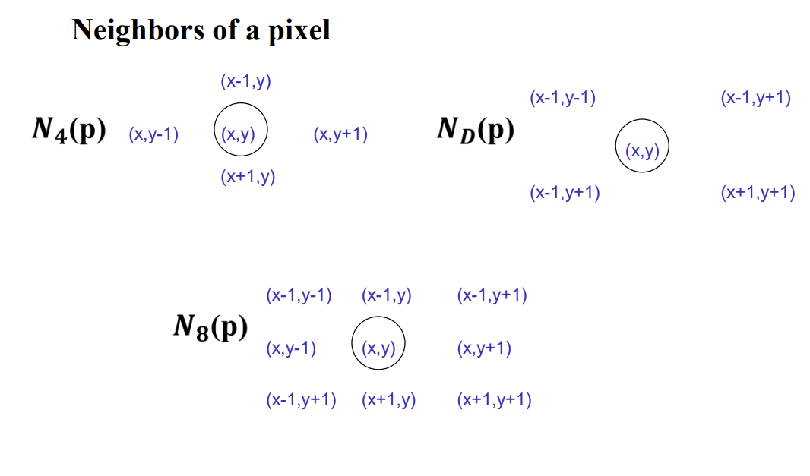
Some Basic Relationships between Pixels

Slide 35
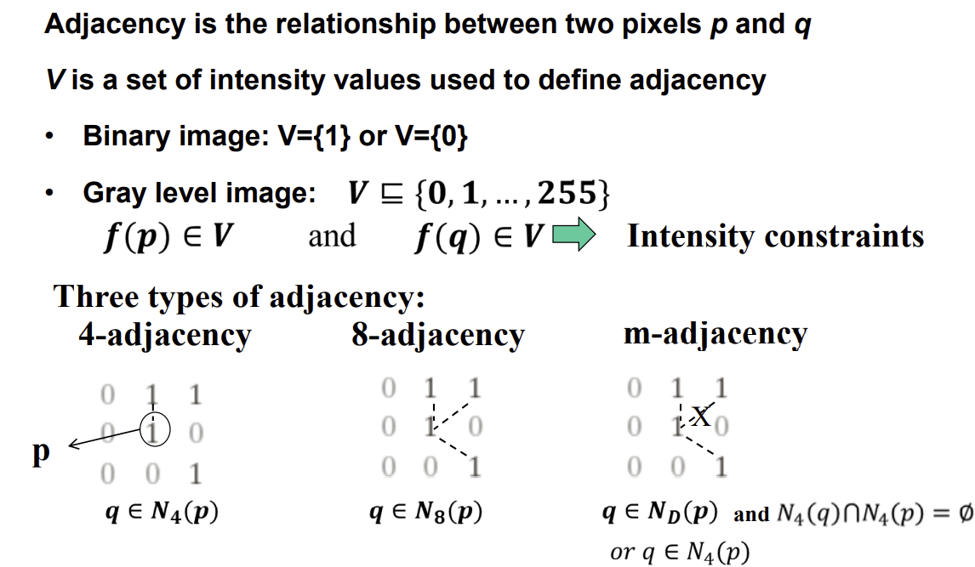
Adjacency

Slide 36
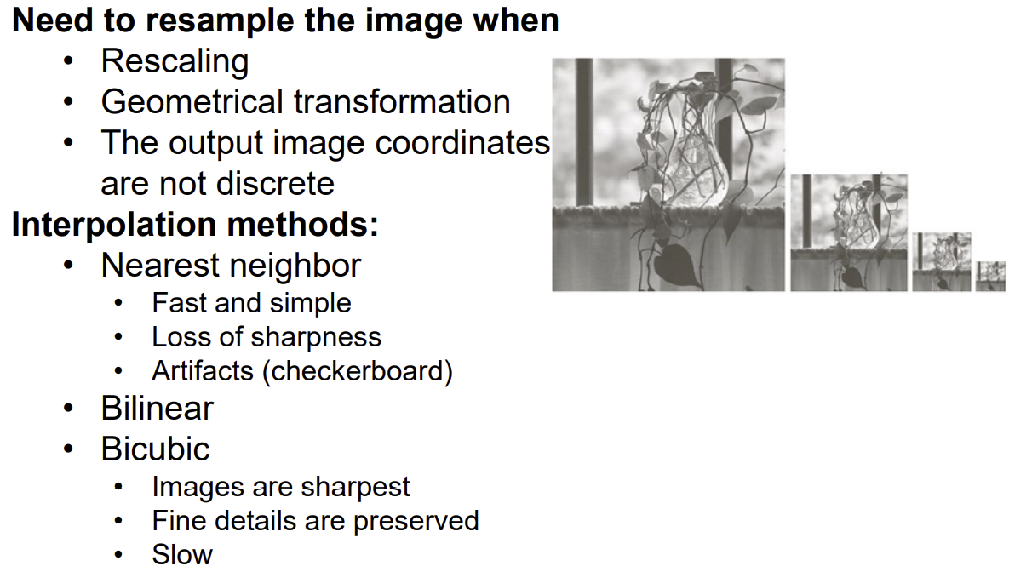
Image Resampling & Interpolation
Notes:
Resize or distortion of image is known as interpolation

Slide 37
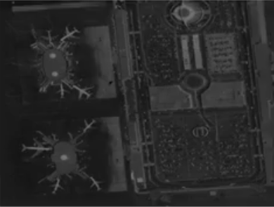
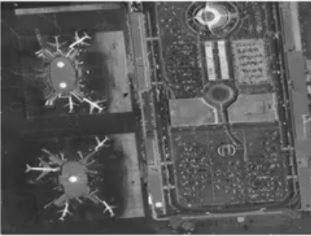
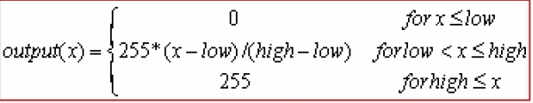
Contrast Stretching

Slide 38
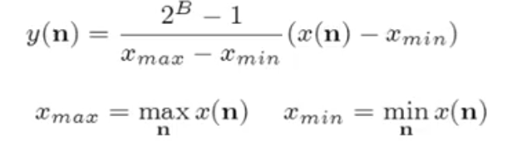
Contrast Stretching
Contrast stretching

Slide 39
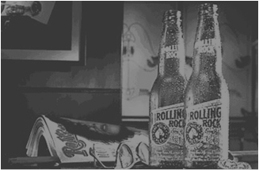
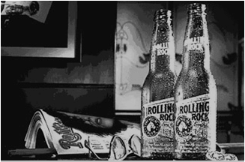
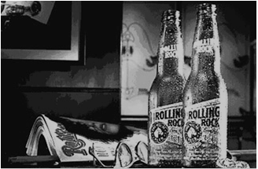
Contrast Stretching
Original Image
Basic Contrast Stretching
Original Image
End-in Search

Slide 40
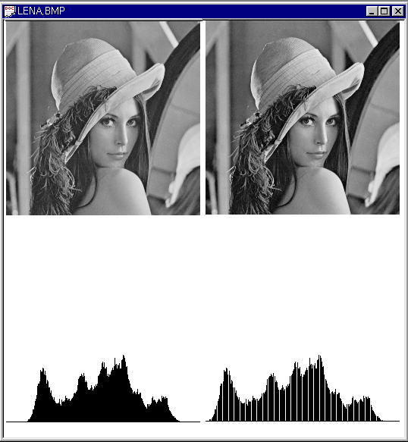
Contrast Stretching
Original Image
Contrast
Stretching
Convert Image

Slide 41
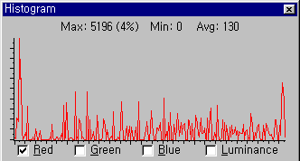
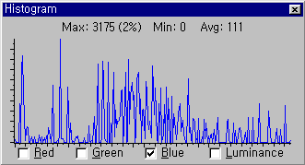
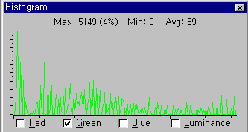
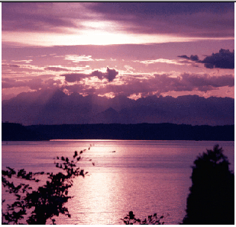
Contrast Stretching
Red
Green
Blue

Slide 42
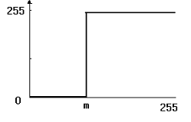
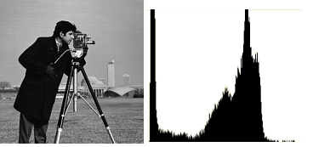
Threshold

Slide 43
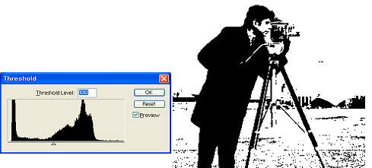
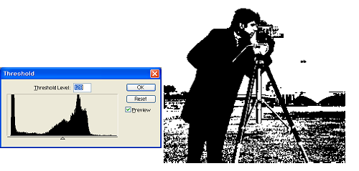
Threshold 128
Threshold 100

Slide 44

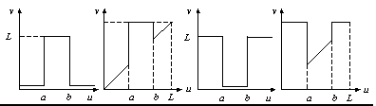
Intensity transformations
Digital negative
  Applications
    Display of medical images
    Produce negative prints of images
Intensity level slicing
  Applications :
    Segmentation of certain gray level regions

Slide 45
Intensity transformations
Intensity transformation
  Convert an old pixel into a new pixel based on some predefined function
  Implemented with simple look-up tables
Simple transformation
  Null transform :
    new pixel = old pixel
  Image negative
    y = -x+255
  Gamma correction function
    Brightness of an image can be adjusted with a gamma correction transformation

Slide 46
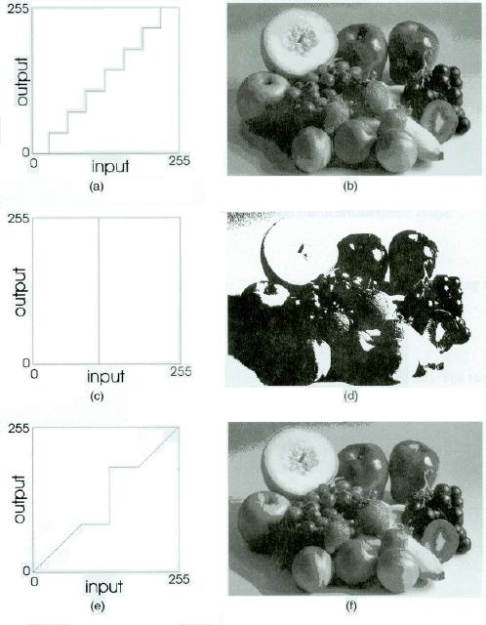
Intensity transformations
Posterizing
  Reduces the number of gray levels in an images
  Thresholding results when number of gray levels is reduced to 2.
  A bounced threshold reduces the thresholding to a limited range and treats the other input pixels as null transformation
(a) 8-Level posterize transformation; (b) posterized image; (c) threshold transformation; (d) threshold image; (e) bounded threshold; (f) bounded threshold image.

Slide 47


Intensity transformations
Gamma correction is important for displaying images on a screen correctly, to prevent bleaching or darkening of images when viewed from different types of monitors with different display settings. This is done because our eyes perceive images in a gamma-shaped curve, whereas cameras capture images in a linear fashion.

Slide 48




Intensity transformations
Gamma correction
Original
gamma=0.45
gamma=2.20

Slide 49




Intensity Transformation
Intensity Transformation
  Intensity transformation is a point process that converts an old pixel into a new pixel base on some predefined function. This transformation is implemented with the LUT with ease.
  Gamma Correction

Slide 50




Intensity Transformation

Slide 51




Intensity Transformation

Slide 52




Intensity Transformation

Slide 53


Intensity transformations
Fig. (a) Null transformation; (b) image;
(c) negative transformation; (d) negative image.
Fig. (a) Gamma collection transformation with gamma=0.45; (b) gamma collected image; (c) gamma collection transformation with gamma=2.2; (d) gamma collected image.

Slide 54

Intensity transformations
Fig. (a) Contrast stretch transformation; (b) contrast stretched image; (c) Contrast compression transformation; (d) contrast compressed image.
Fig. (a) 8-Level posterize transformation; (b) posterized image; (c) threshold transformation; (d) threshold image; (e) bounded threshold; (f) bounded threshold image.

Slide 55



Intensity transformations
Fig. 2.19 (a) 2-bit bit-clipping transformation;
(b) resulting image.
Fig. Bit clipped image contrast stretched.
Fig. (a) Iso-intensity contouring transformation; (b) contoured image.

Slide 56


Intensity tranformations
Fig. (a) Range-highlighting transformation;
(b) resulting image.
Fig. (a) Solarize transformation using a
threshold of 150; (b) solarize image.

Slide 57

Intensity tranformations
Fig. (a) First parabola transformation; (b) transformed image; (c) second parabola transformation; (d) second transformed image.

Slide 58


Histogram
Histogram
  A simple bar graph that stands for pixel intensities.
    The pixel intensities are plotted along the x-axis and the number of occurrences for each intensity are plotted along the y-axis.
    Provide information about contrast and overall intensity distribution of an image

Slide 59



Histogram

Slide 60

Histogram
Original Image + 40
Original Image
Original Image - 40

Slide 61

Histogram
Original Image * 1.2
Original Image
Original Image / 1.2

Slide 62


Histogram

Slide 63


Histogram
Histogram in Gray-level and Color Image
RGB
Gray

Slide 64

Histogram Equalization
Histogram Equalization
  (Goal) to obtain a uniform histogram for the output image
    Mapping of gray level r into gray level s s.t. the distribution of gray level s is uniform.
    Spreading: the peaks and valleys will be shifted (due to approximation in digitized space)
Histogram Equalization Steps
  Compute histogram.
  Calculate normalized sum of histogram
  Transform input image to output image
Histograms of an image before and after equalization.

Slide 65

Reference
Textbook
Image processing

Slide 66

Question

Slide 67

Thank you

